Slide 1
Recurrent Neural Networks

Slide 2
RNN
A recurrent neural network (RNN) is a special type of an artificial neural network adapted to work for time series data or data that involves sequences. ...
RNNs have the concept of 'memory' that helps them store the states or information of previous inputs to generate the next output of the sequence
The main difference between a CNN and an RNN is the ability to process temporal information — data that comes in sequences, such as a sentence.
Recurrent neural networks are designed for this very purpose, while convolutional neural networks are incapable of effectively interpreting temporal information.

Slide 3
Applications
Speech recognition involves converting a sequence of audio signals to a sequence of words.
Video captioning involves converting a sequence of video frames to a sequence of words.
Natural language processing tasks such as question answering involve addressing a question (a sequence of words) into an answer (another sequence of words).

Slide 4
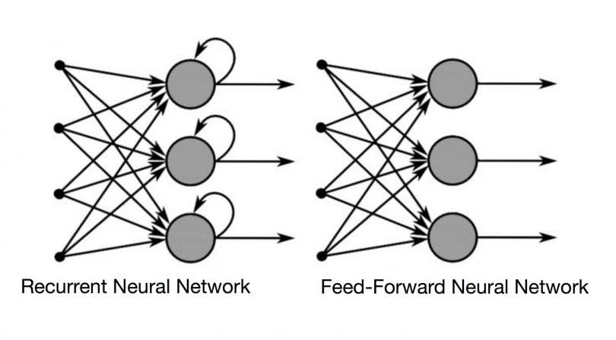
RNN VS. FEED-FORWARD NEURAL NETWORKS

Slide 5
RNN VS. FEED-FORWARD NEURAL NETWORKS
In a feed-forward neural network, the information only moves in one direction — from the input layer, through the hidden layers, to the output layer.
The information moves straight through the network and never touches a node twice.
Feed-forward neural networks have no memory of the input they receive and are bad at predicting what’s coming next.
Because a feed-forward network only considers the current input, it has no notion of order in time.
It simply can’t remember anything about what happened in the past except its training.
While feedforward networks have different weights across each node, recurrent neural networks share the same weight parameter within each layer of the network.

Slide 6
RNN
In RNN the information cycles through a loop.
When it makes a decision, it considers the current input and also what it has learned from the inputs it received previously.
Another good way to illustrate the concept of a recurrent neural network's memory is to explain it with an example:
Imagine you have a normal feed-forward neural network and give it the word "neuron" as an input and it processes the word character by character. By the time it reaches the character "r," it has already forgotten about "n," "e" and "u," which makes it almost impossible for this type of neural network to predict which character would come next.

Slide 7
RNN
RNN as a sequence of neural networks that you train one after another with backpropagation.
While RNNs learn similarly while training, in addition, they remember things learnt from prior input(s) while generating output(s).
RNNs can take one or more input vectors and produce one or more output vectors and the output(s) are influenced not just by weights applied on inputs like a regular NN, but also by a “hidden” state vector representing the context based on prior input(s)/output(s).
Recurrent neural networks apply the same weights for each element of the sequence, significantly reducing the number of parameters and allowing the model to generalize to variable length sequences.
So, the same input could produce a different output depending on previous inputs in the series.

Slide 8
RNN
A recurrent neural network, however, is able to remember those characters because of its internal memory. It produces output, copies that output and loops it back into the network.
recurrent neural networks add the immediate past to the present.
Therefore, a RNN has two inputs: the present and the recent past. This is important because the sequence of data contains crucial information about what is coming next, which is why a RNN can do things other algorithms can’t.

Slide 9
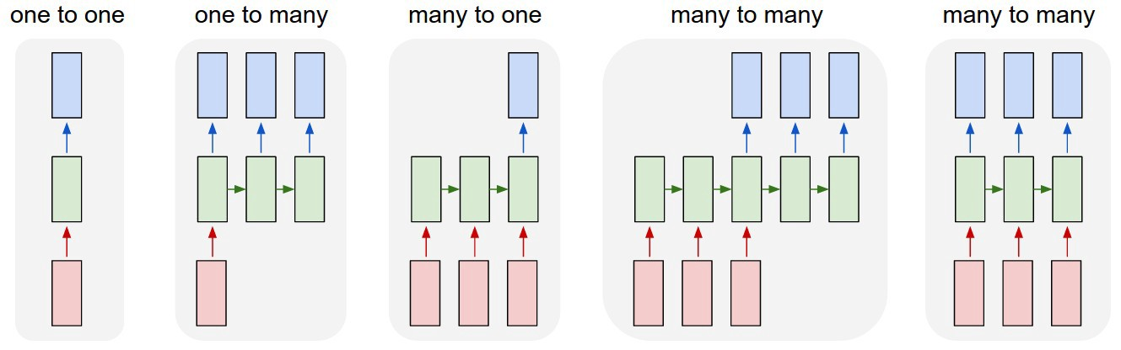
Different types of RNN

Slide 10
Different types of RNN
One-to-one:
It deals with Fixed size of input to Fixed size of Output where they are independent of previous information/output.
Ex: Image classification.
One-to-Many:
it deals with fixed size of information as input that gives sequence of data as output.
Ex:Image Captioning takes image as input and outputs a sentence of words.

Slide 11
Different types of RNN
Many-to-One:
It takes Sequence of information as input and ouputs a fixed size of output.
Ex:sentiment analysis where a given sentence is classified as expre
ssing positive or negative sentiment.
Many-to-Many:
It takes a Sequence of information as input and process it recurrently outputs a Sequence of data.
Ex: Machine Translation, where an RNN reads a sentence in English and then outputs a sentence in French.

Slide 12
Limitations:
This method of Back Propagation through time (BPTT) can be used up to a limited number of time steps like 8 or 10.
If we back propagate further, the gradient becomes too small.
This problem is called the “Vanishing gradient” problem.
The problem is that the contribution of information decays geometrically over time.
One of the famous solutions to this problem is by using what is called Long Short-Term Memory (LSTM for short) cells instead of the traditional RNN cells.

Slide 13
Two issues of standard RNN’s
There are two major obstacles RNN’s have had to deal with, but to understand them, you first need to know what a gradient is.
A gradient is a partial derivative with respect to its inputs. If you don’t know what that means, just think of it like this: a gradient measures how much the output of a function changes if you change the inputs a little bit.
You can also think of a gradient as the slope of a function.
The higher the gradient, the steeper the slope and the faster a model can learn.
But if the slope is zero, the model stops learning. A gradient simply measures the change in all weights with regard to the change in error.

Slide 14
1,VANISHING GRADIENTS
Vanishing gradients occur when the values of a gradient are too small and the model stops learning or takes way too long as a result.
This was a major problem in the 1990s and much harder to solve than the exploding gradients.
Fortunately, it was solved through the concept of LSTM by Sepp Hochreiter and Juergen Schmidhuber.
While you are using Backpropogating through time, you find Error is the difference of Actual and Predicted model.
Now what if the partial derivation of error with respect to weight is very less than 1?

Slide 15
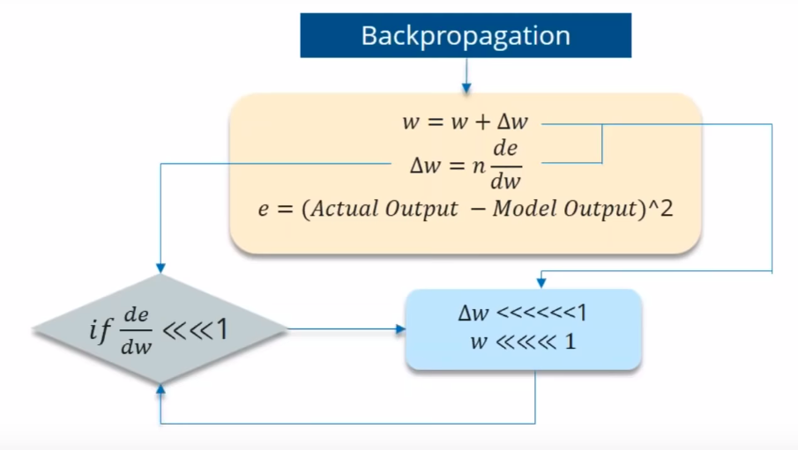

Slide 16
If the partial derivation of Error is less than 1, then when it get multiplied with the Learning rate which is also very less.
Then Multiplying learning rate with partial derivation of Error wont be a big change when compared with previous iteration.
For ex:- Lets say the value decreased like 0.863 →0.532 →0.356 →0.192 →0.117 →0.086 →0.023 →0.019..
you can see that there is no much change in last 3 iterations. This Vanishing of Gradience is called Vanishing Gradience.

Slide 17
2,EXPLODING GRADIENTS
where the gradient grows uncontrollably large.
Fortunately, this problem can be easily solved by truncating or squashing the gradients.
Exploding gradients are when the algorithm, without much reason, assigns a stupidly high importance to the weights.
A popular method called gradient clipping can be used where in each time step, we can check if the gradient> threshold. If yes, then normalize it.

Slide 18
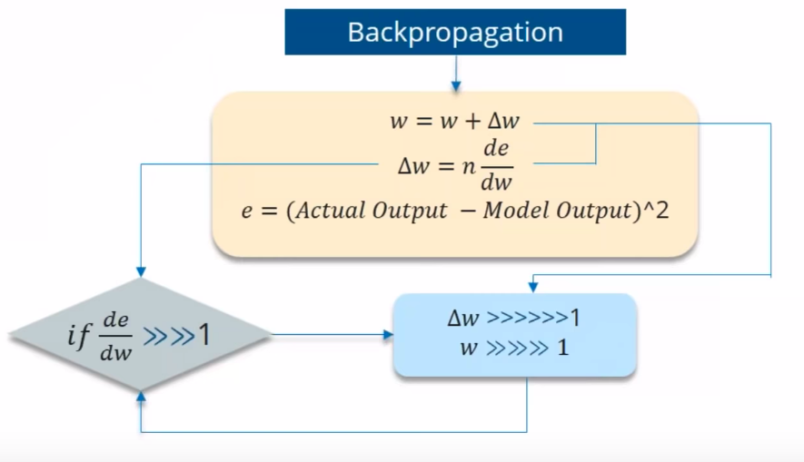
EXPLODING GRADIENTS

Slide 19
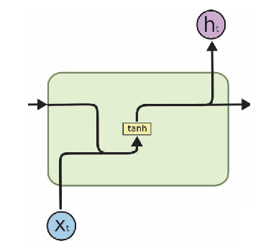
RNN

Slide 20
Long Short-Term Memory (LSTM)
The units of an LSTM are used as building units for the layers of a RNN, often called an LSTM network.
LSTMs enable RNNs to remember inputs over a long period of time.
This is because LSTMs contain information in a memory, much like the memory of a computer.
The LSTM can read, write and delete information from its memory.
LSTM is well-suited to classify, process and predict time series given time lags of unknown duration.

Slide 21
This memory can be seen as a gated cell, with gated meaning the cell decides whether or not to store or delete information (i.e., if it opens the gates or not), based on the importance it assigns to the information.
The assigning of importance happens through weights, which are also learned by the algorithm.
This simply means that it learns over time what information is important and what is not.

Slide 22
In an LSTM you have three gates: input, forget and output gate.
These gates determine whether or not to let new input in (input gate), delete the information because it isn’t important (forget gate), or let it impact the output at the current timestep (output gate).
Below is an illustration of a RNN with its three gates:

Slide 23
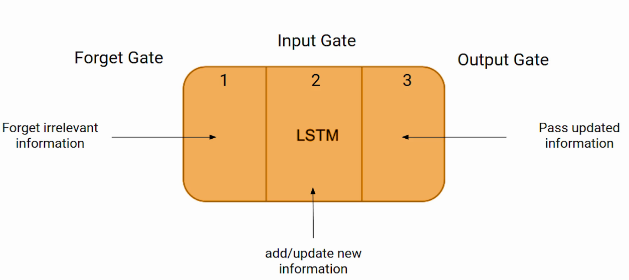

Slide 24
These three parts of an LSTM cell are known as gates. The first part is called Forget gate, the second part is known as the Input gate and the last one is the Output gate.
The LSTM consists of three parts, as shown in the image below and each part performs an individual function.
The first part chooses whether the information coming from the previous timestamp is to be remembered or is irrelevant and can be forgotten.
In the second part, the cell tries to learn new information from the input to this cell.
At last, in the third part, the cell passes the updated information from the current timestamp to the next timestamp.

Slide 25
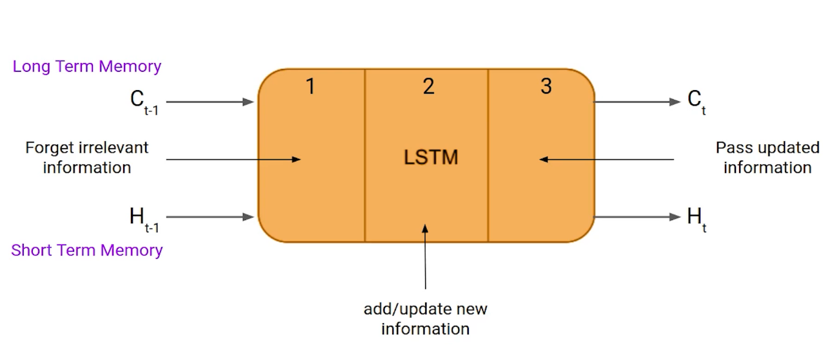

Slide 26
Just like a simple RNN, an LSTM also has a hidden state where H(t-1) represents the hidden state of the previous timestamp and Ht is the hidden state of the current timestamp.
In addition to that LSTM also have a cell state represented by C(t-1) and C(t) for previous and current timestamp respectively.
Here the hidden state is known as Short term memory and the cell state is known as Long term memory. Refer to the above image.

Slide 27
Let’s take an example to understand how LSTM works. Here we have two sentences separated by a full stop. The first sentence is “Bob is a nice person” and the second sentence is “Dan, on the Other hand, is evil”. It is very clear, in the first sentence we are talking about Bob and as soon as we encounter the full stop(.) we started talking about Dan.
As we move from the first sentence to the second sentence, our network should realize that we are no more talking about Bob. Now our subject is Dan. Here, the Forget gate of the network allows it to forget about it. Let’s understand the roles played by these gates in LSTM architecture(context change).

Slide 28

LSTM had a three step Process:

Slide 29
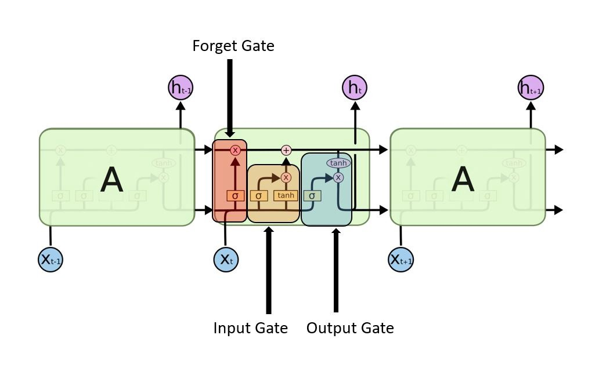
Different view of LSTM

Slide 30
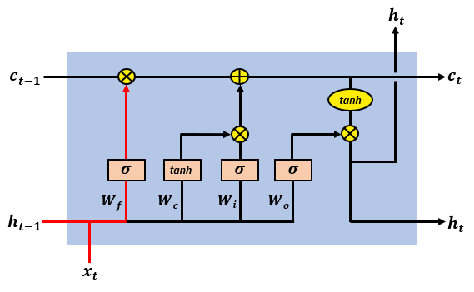
Different view of LSTM

Slide 31
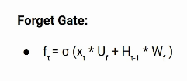
Forget Gate
In a cell of the LSTM network, the first step is to decide whether we should keep the information from the previous timestamp or forget it. Here is the equation for forget gate.

Slide 32
Xt: input to the current timestamp.
Uf: weight associated with the input
Ht-1: The hidden state of the previous timestamp
Wf: It is the weight matrix associated with hidden state
Later, a sigmoid function is applied over it. That will make ft a number between 0 and 1.
This ft is later multiplied with the cell state of the previous timestamp as shown below.

Slide 33
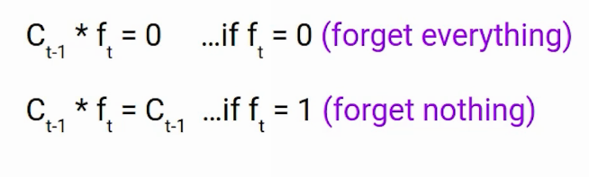

Slide 34
If ft is 0 then the network will forget everything and if the value of ft is 1 it will forget nothing.
Let’s get back to our example, The first sentence was talking about Bob and after a full stop, the network will encounter Dan, in an ideal case the network should forget about Bob.
The output of the forget gate tells the cell state which information to forget by multiplying 0 to a position in the matrix.
If the output of the forget gate is 1, the information is kept in the cell state. From equation, sigmoid function is applied to the weighted input/observation and previous hidden state.

Slide 35
Decides how much of the past you should remember.
This gate Decides which information to be omitted in from the cell in that particular time stamp.
It is decided by the sigmoid function.
it looks at the previous state(ht-1) and the content input(Xt) and outputs a number between 0(omit this)and 1(keep this)for each number in the cell state Ct−1.

Slide 36
Input Gate
Let’s take another example
“Bob knows swimming. He told me over the phone that he had served the navy for four long years.”
So, in both these sentences, we are talking about Bob. However, both give different kinds of information about Bob. In the first sentence, we get the information that he knows swimming. Whereas the second sentence tells he uses the phone and served in the navy for four years.
Now just think about it, based on the context given in the first sentence, which information of the second sentence is critical. First, he used the phone to tell or he served in the navy. In this context, it doesn’t matter whether he used the phone or any other medium of communication to pass on the information. The fact that he was in the navy is important information and this is something we want our model to remember. This is the task of the Input gate.

Slide 37
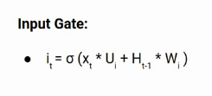
Input gate is used to quantify the importance of the new information carried by the input. Here is the equation of the input gate.

Slide 39
Output Gate
Now consider this sentence
“Bob single-handedly fought the enemy and died for his country. For his contributions, brave________ .”
During this task, we have to complete the second sentence. Now, the minute we see the word brave, we know that we are talking about a person. In the sentence only Bob is brave, we can not say the enemy is brave or the country is brave. So based on the current expectation we have to give a relevant word to fill in the blank. That word is our output and this is the function of our Output gate.

Slide 40

Its value will also lie between 0 and 1 because of this sigmoid function.

Slide 41

Now to calculate the current hidden state we will use Ot and tanh of the updated cell state. As shown below.

Slide 42

It turns out that the hidden state is a function of Long term memory (Ct) and the current output. If you need to take the output of the current timestamp just apply the SoftMax activation on hidden state Ht.

Slide 43
Decides which part of the current cell makes it to the output.
Sigmoid function decides which values to let through 0,1. and tanh function gives weightage to the values which are passed deciding their level of importance ranging from-1 to 1 and multiplied with output of Sigmoid.

Slide 44
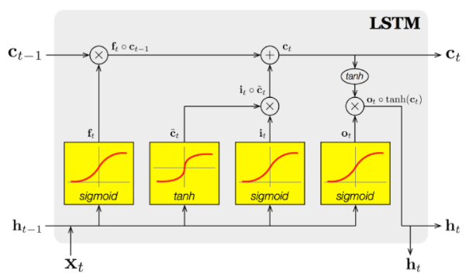
Another view of LSTM cell.

Slide 45
The first sigmoid activation function is the forget gate.
Which information should be forgotten from the previous cell state (Ct-1).
The second sigmoid and first tanh activation function is our input gate.
Which information should be saved to the cell state or should be forgotten?
The last sigmoid is the output gate and highlights which information should be going to the next hidden state.

Slide 46
Reduce vanishing Gradient
The problematic issues of vanishing gradients is solved through LSTM because it keeps the gradients steep enough, which keeps the training relatively short and the accuracy high.
During forward propagation, gates control the flow of the information. They prevent any irrelevant information from being written to the state.
Similarly, during backward propagation, they control the flow of the gradients. It is easy to see that during the backward pass, gradients will get multiplied by the gate.

Slide 47
Gated Recurrent Units (GRU)
Introduced in 2014, GRU (Gated Recurrent Unit) aims to solve the vanishing gradient problem
These networks are designed to handle the vanishing gradient problem.
They have a reset and update gate.
These gates determine which information is to be retained for future predictions.
GRU can also be considered as a variation on the LSTM because both are designed similarly and, in some cases, produce equally excellent results.

Slide 48
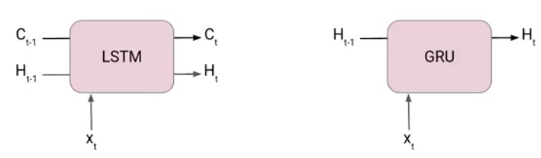
LSTM Vs GRU

Slide 49
Another Interesting thing about GRU is that, unlike LSTM, it does not have a separate cell state (Ct).
It only has a hidden state(Ht).
The information which is stored in the Internal Cell State in an LSTM recurrent unit is incorporated into the hidden state of the Gated Recurrent Unit.
Due to the simpler architecture, GRUs are faster to train.

Slide 50
Update Gate
The update gate acts similar to the forget and input gate of an LSTM. It decides what information to throw away and what new information to add.
Reset Gate
The reset gate is another gate is used to decide how much past information to forget.

Slide 51
To solve the vanishing gradient problem of a standard RNN, GRU uses, so-called, update gate and reset gate.
Basically, these are two vectors which decide what information should be passed to the output.
The special thing about them is that they can be trained to keep information from long ago, without washing it through time or remove information which is irrelevant to the prediction.

Slide 52
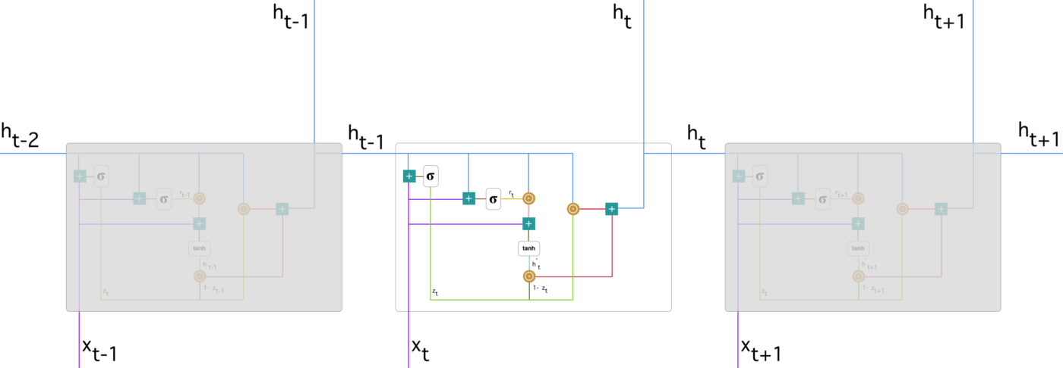

Slide 53
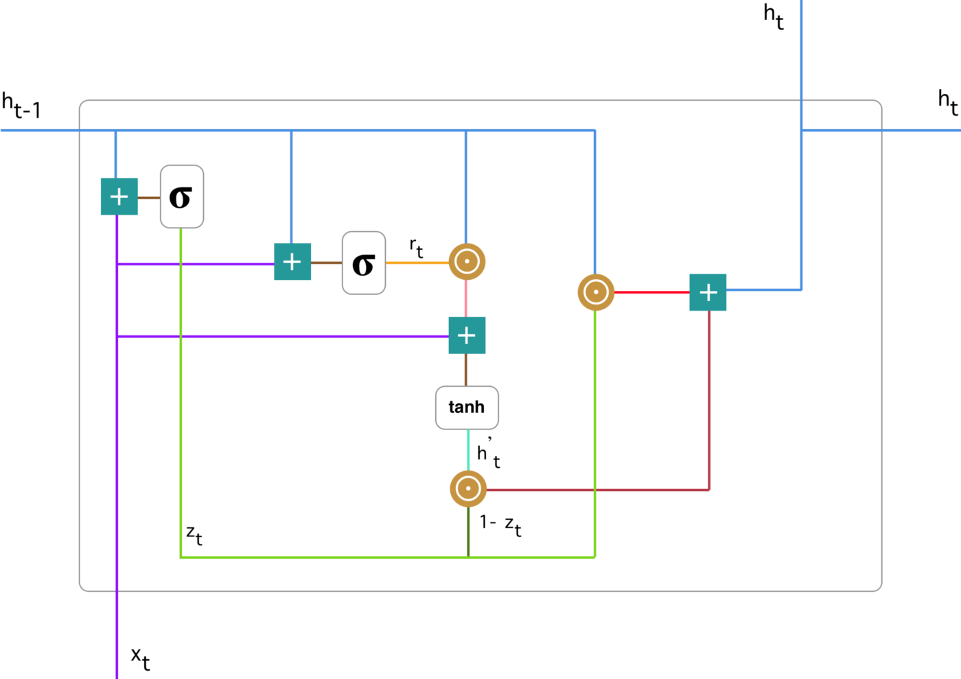
GRU unit

Slide 54
Update gate
We start with calculating the update gate z_t for time step t using the formula:

Slide 55
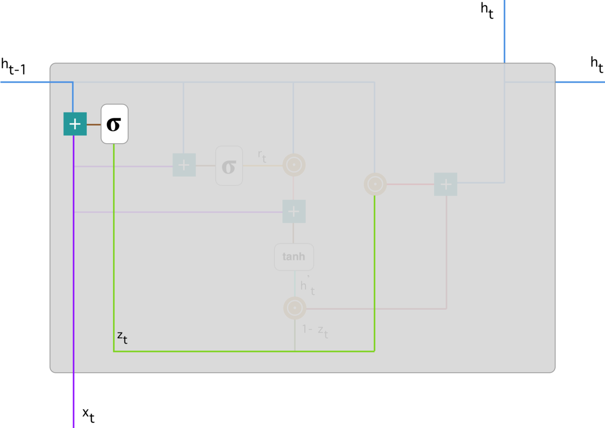
Update gate

Slide 56
When x_t is plugged into the network unit, it is multiplied by its own weight W(z).
The same goes for h_(t-1) which holds the information for the previous t-1 units and is multiplied by its own weight U(z).
Both results are added together and a sigmoid activation function is applied to squash the result between 0 and 1.

Slide 57
The update gate helps the model to determine how much of the past information (from previous time steps) needs to be passed along to the future.
That is really powerful because the model can decide to copy all the information from the past and eliminate the risk of vanishing gradient problem.

Slide 58
Reset gate
Essentially, this gate is used from the model to decide how much of the past information to forget.
To calculate it, we use:

Slide 59
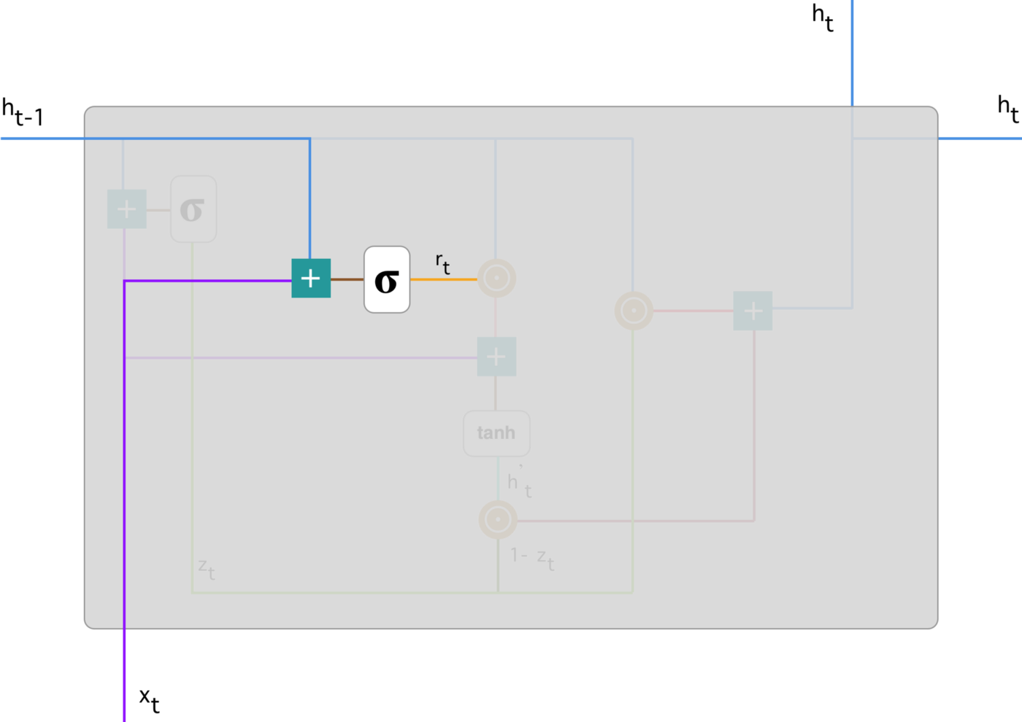
Reset gate

Slide 60
This formula is the same as the one for the update gate.
The difference comes in the weights and the gate’s usage.
As before, we plug in h_(t-1) — blue line and x_t — purple line, multiply them with their corresponding weights, sum the results and apply the sigmoid function.

Slide 61
Current memory content
Let’s see how exactly the gates will affect the final output.
First, we start with the usage of the reset gate.
We introduce a new memory content which will use the reset gate to store the relevant information from the past.
It is calculated as follows:

Slide 62
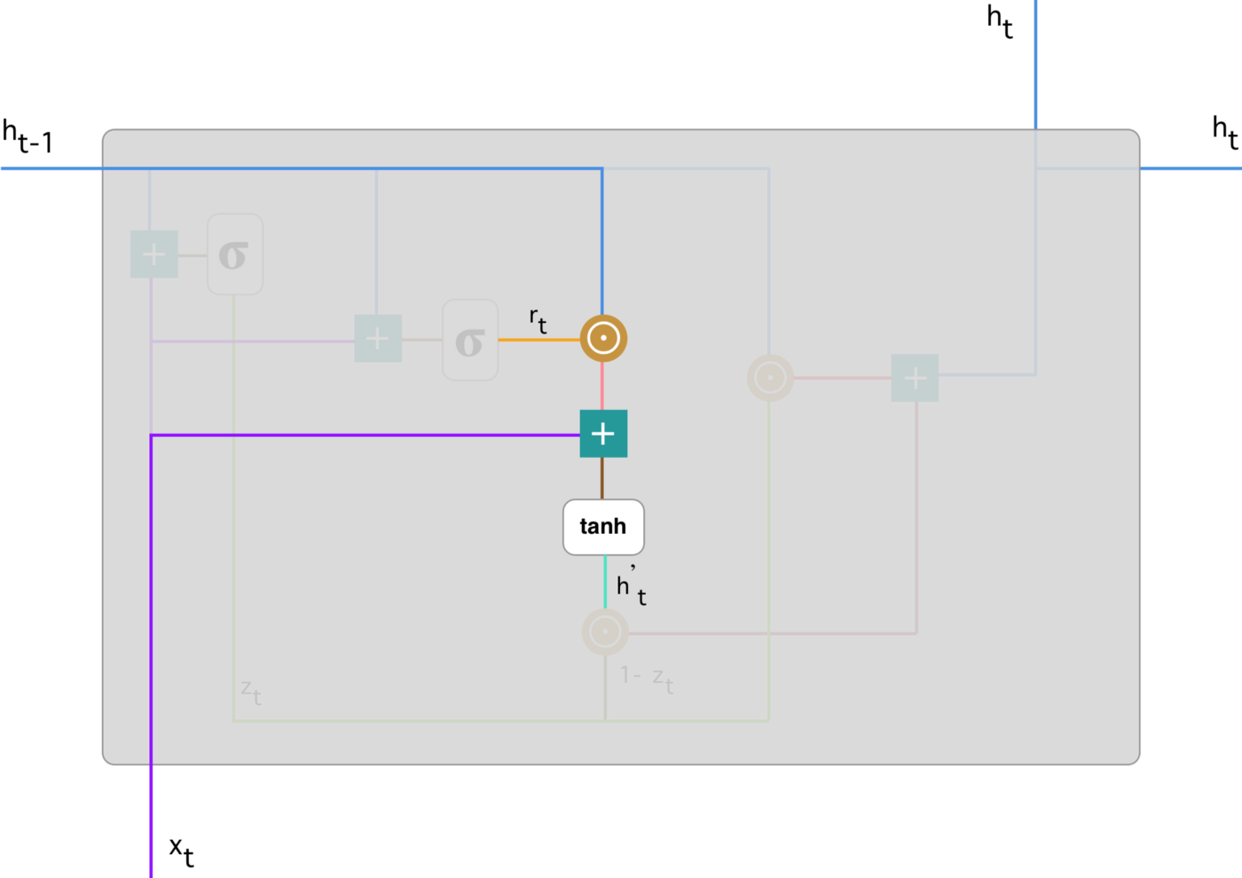
Current memory content

Slide 63
Step-1: Multiply the input x_t with a weight W and h_(t-1) with a weight U.
Step-2: Calculate the Hadamard (element-wise) product between the reset gate r_t and Uh_(t-1).
That will determine what to remove from the previous time steps.
Consider an example:

Slide 64
That will determine what to remove from the previous time steps. Let’s say we have a sentiment analysis problem for determining one’s opinion about a book from a review he wrote. The text starts with “This is a fantasy book which illustrates…” and after a couple paragraphs ends with “I didn’t quite enjoy the book because I think it captures too many details.” To determine the overall level of satisfaction from the book we only need the last part of the review. In that case as the neural network approaches to the end of the text it will learn to assign r_t vector close to 0, washing out the past and focusing only on the last sentences.
Step-3 :Sum up the results of step 1 and 2.
Step 4: Apply the nonlinear activation function tanh.

Slide 65
Final memory at current time step
As the last step, the network needs to calculate h_t — vector which holds information for the current unit and passes it down to the network.
In order to do that the update gate is needed.
It determines what to collect from the current memory content — h’_t and what from the previous steps — h_(t-1). That is done as follows:

Slide 66
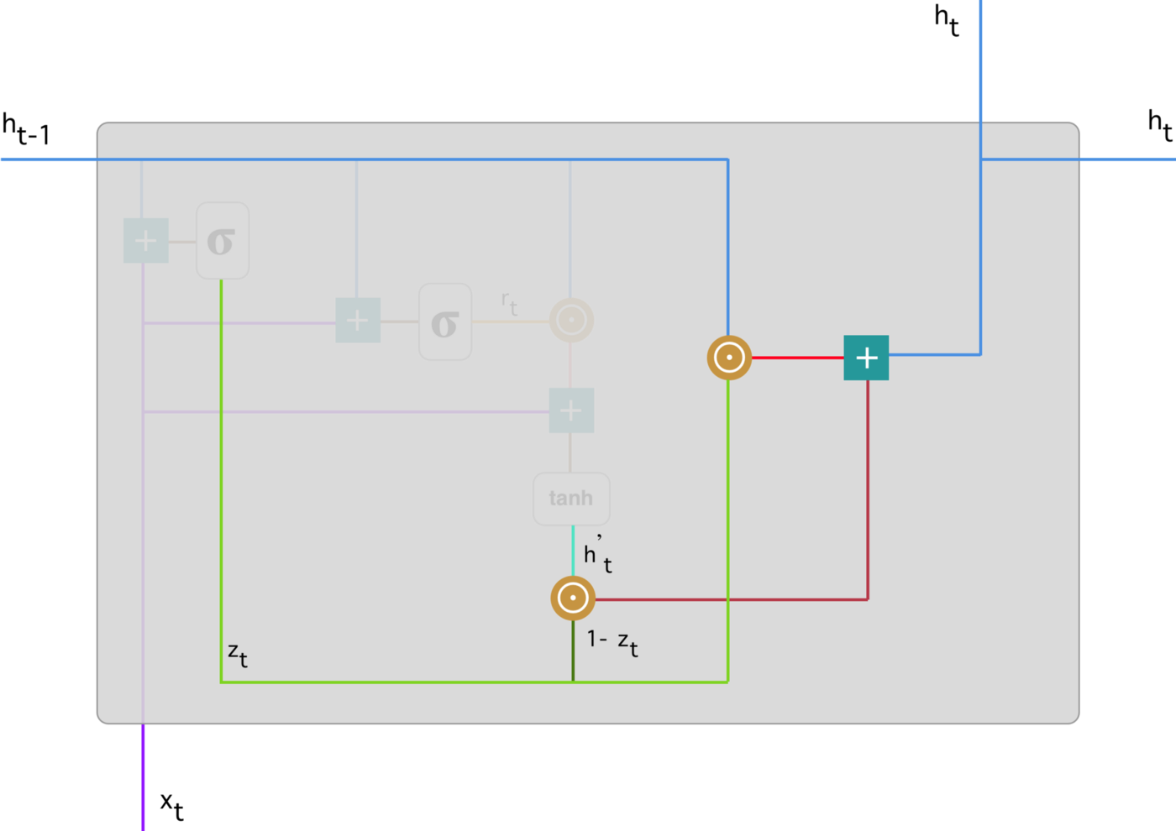

Slide 67
Final output

Slide 68
Step 1:Apply element-wise multiplication to the update gate z_t and h_(t-1).
Step 2 :Apply element-wise multiplication to (1-z_t) and h’_t.
Step 3 :Sum the results from step 1 and 2.

Slide 69
Let’s bring up the example about the book review. This time, the most relevant information is positioned in the beginning of the text. The model can learn to set the vector z_t close to 1 and keep a majority of the previous information. Since z_t will be close to 1 at this time step, 1-z_t will be close to 0 which will ignore big portion of the current content (in this case the last part of the review which explains the book plot) which is irrelevant for our prediction.

Slide 70
GRU Network

Slide 71
Now, you can see how GRUs are able to store and filter the information using their update and reset gates.
That eliminates the vanishing gradient problem since the model is not washing out the new input every single time but keeps the relevant information and passes it down to the next time steps of the network.
If carefully trained, they can perform extremely well even in complex scenarios.

Slide 72
RNN:
https://www.youtube.com/watch?v=6EXP2-d_xQA
https://www.youtube.com/watch?v=mDaEfPgwtgo
LSTM:
https://www.youtube.com/watch?v=XsFkGGlocc4
https://www.youtube.com/watch?v=rdkIOM78ZPk
GRU:
https://www.youtube.com/watch?v=xLKSMaYp2oQ
https://www.youtube.com/watch?v=tOuXgORsXJ4

